Slide 1
Dropper Line Overview

Slide 2
Line Overview
Silica Gel sachet feeder
Assembly Module 1
(30ppm)
Tray Feeder
(60ppm)
Assembly Module 2
(30ppm)
Main Conveyor / Cabinet

Slide 3
Main Conveyor
Line stack light
Main Conveyor / Cabinet
Cognex Vision and Reject
Sachet feeder interface
Tray feeder interface

Slide 4
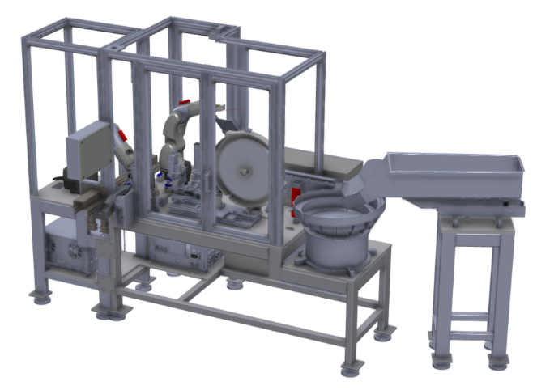
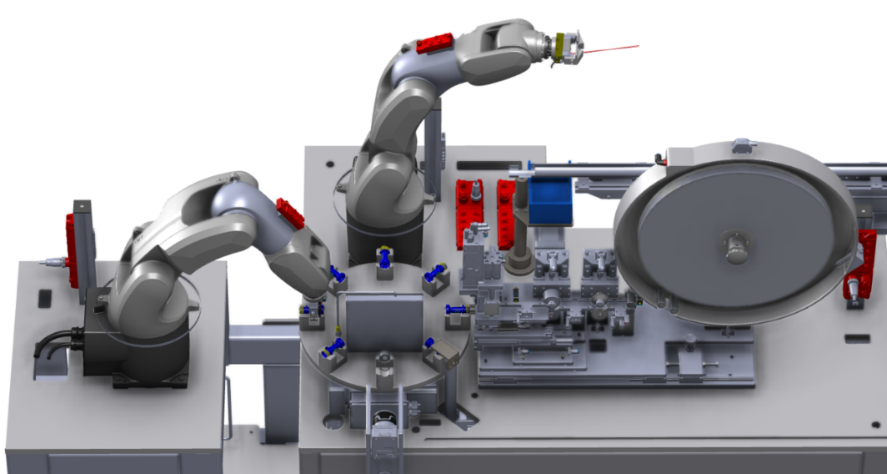
Assembly Modules (x2 per Line)
HMI
(AB)
Control Cabinet
Insertion Vision (Cognex)
Infeed Robot (Kuka KR3)
Insertion Module
Outfeed Robot (Kuka KR3)
Bowl Feeder (RNA)
Hopper Feeder (RNA)
Turntable
Material Chamber

Slide 5
Installation Sequence

Slide 6
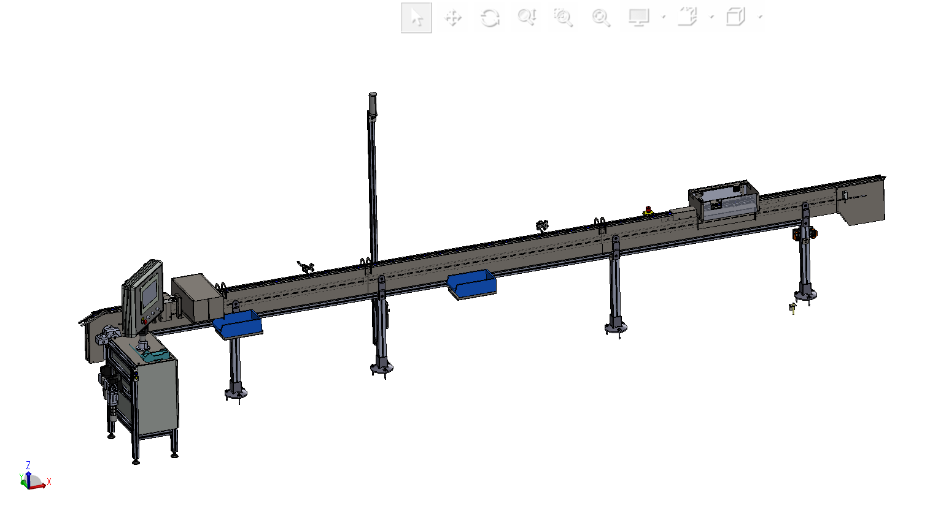
Dropper Line Installation Sequence
Conveyor

Slide 7
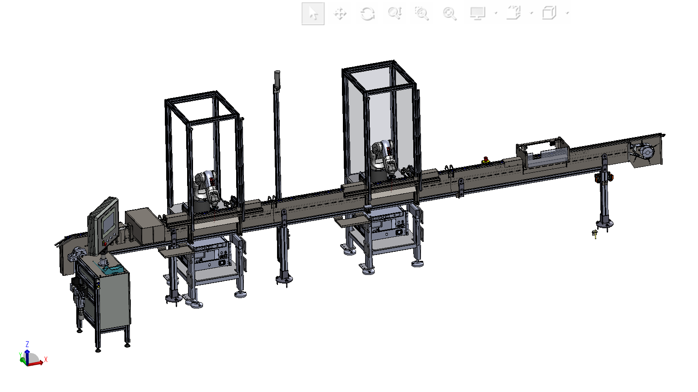
Dropper Line Installation Sequence
Assembly – Outfeed Robots

Slide 8
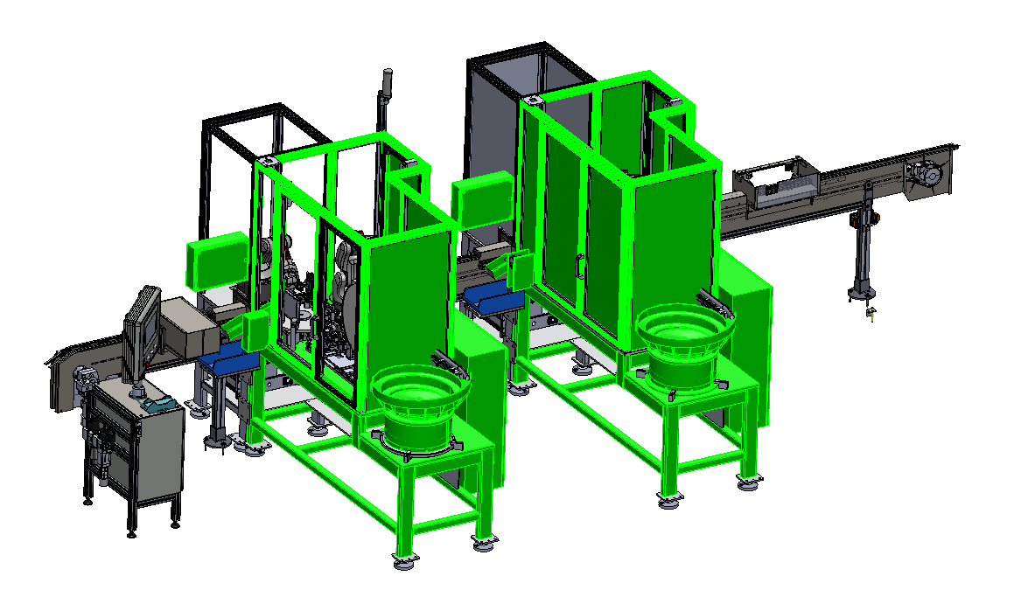
Dropper Line Installation Sequence
Assembly – Main assembly

Slide 9
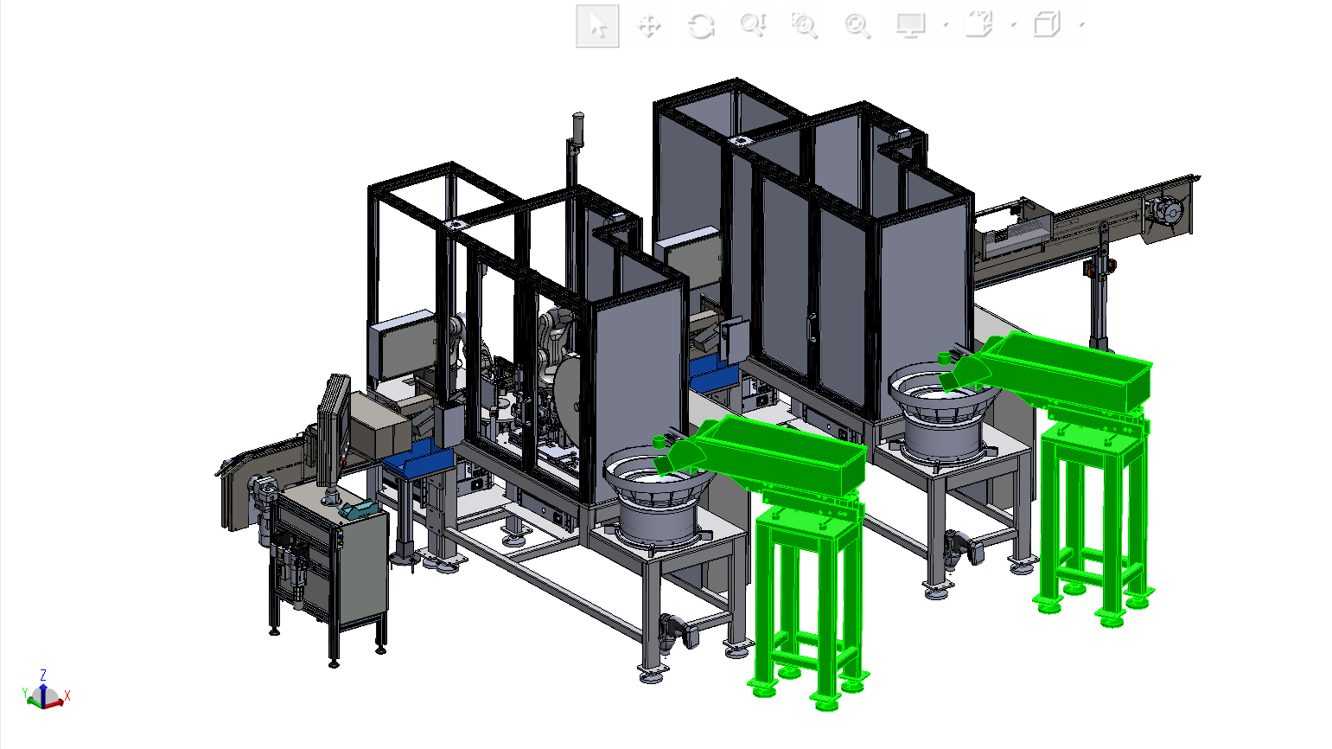
Dropper Line Installation Sequence
Assembly - Hoppers

Slide 10
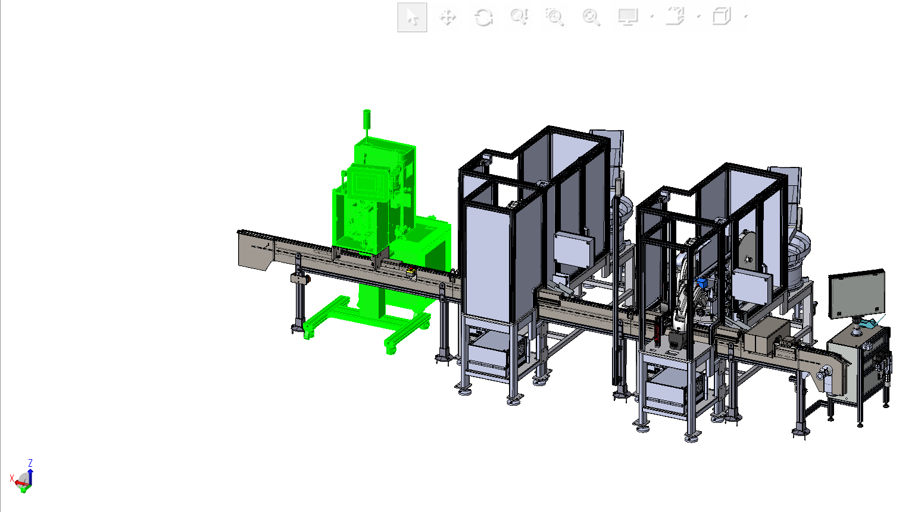
Dropper Line Installation Sequence
Wisesorbent Sachet Feeder

Slide 11
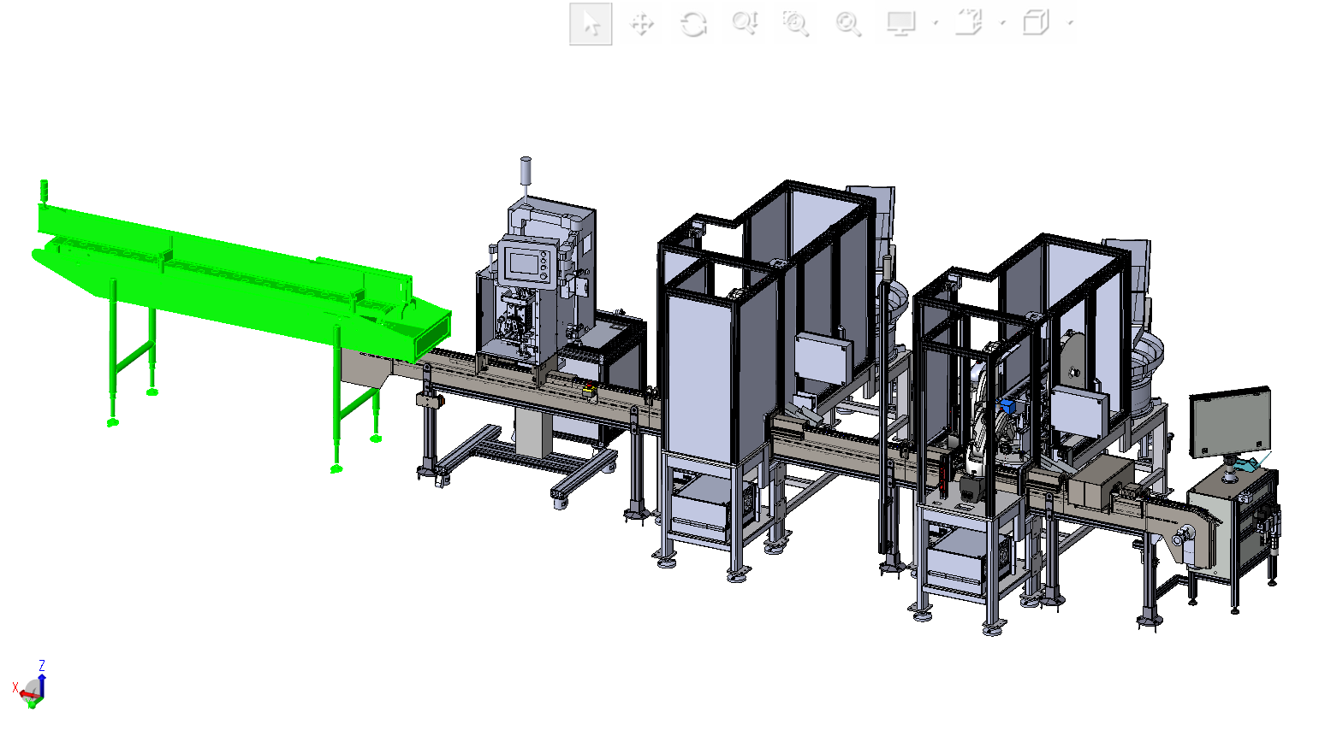
Dropper Line Installation Sequence
Intech/Qupaq Tray feeder

